Slide 1
An in depth analysis of CVE-2013-3906
Frank Boldewin

Slide 2
CVE-2013-3906 Description
GDI+ integer overflow in Microsoft Windows
Vista SP2
Server 2008 SP2
Office 2003 SP3
Office 2007 SP3
Office 2010 SP1 and SP2
Allows remote attackers to execute arbitrary code via a crafted TIFF image embedded in a Word document
First seen exploited in the wild in October 2013
http://www.cve.mitre.org/cgi-bin/cvename.cgi?name=CVE-2013-3906

Slide 3
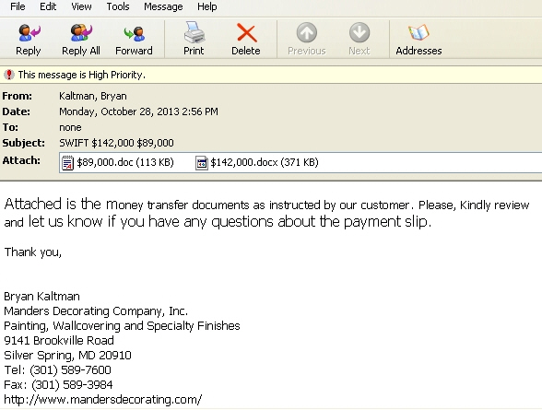
Infection via mail with MS Office attachment

Slide 4
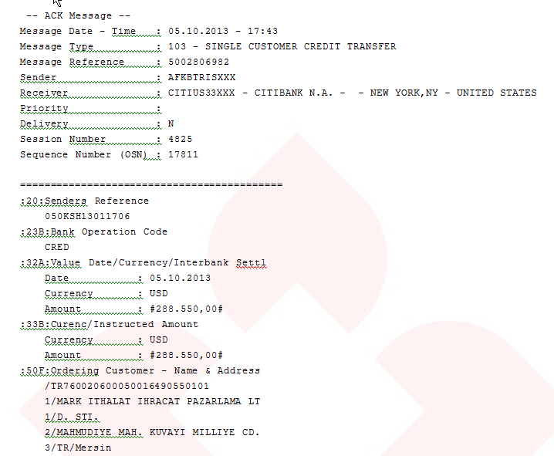
Opened docx file looks harmless

Slide 5
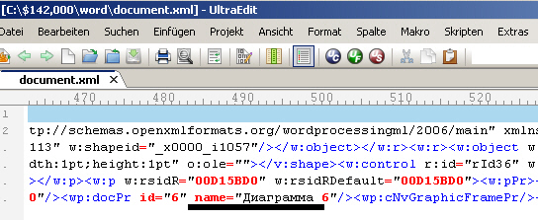
Unzipped docx file – cyrillic characters give hints to its origin
Unzipped docx file – evil TIFF image causing the integer overflow

Slide 6
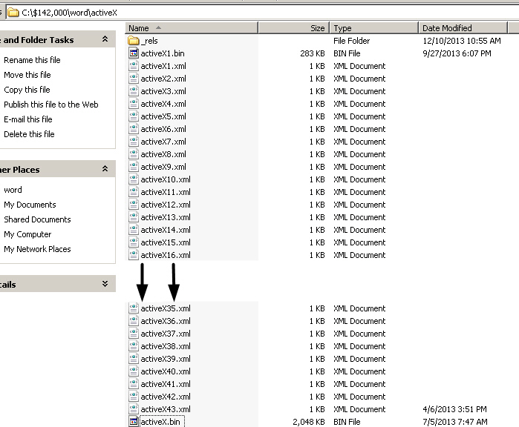
Unzipped docx file – ActiveX directory

Slide 7
ActiveX heap-spraying
New technique introducted for the first time in CVE-2013-3906
Winword performs heap-spray, so no extra code is needed
As usual shellcode is sprayed multiple times in memory by activex.bin
Shellcode uses decryption loop to avoid detection by known patterns

Slide 8
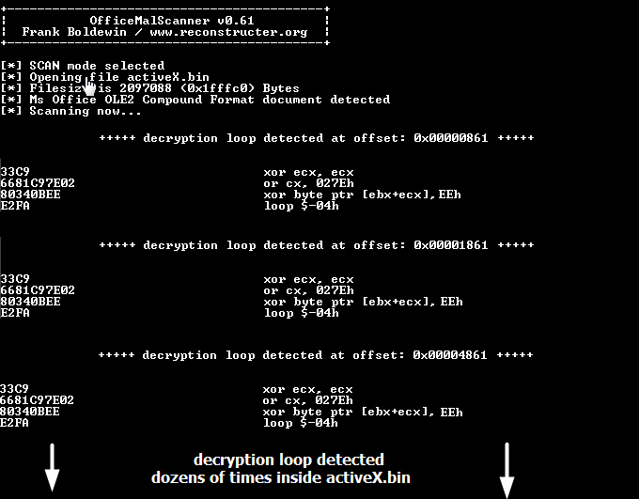
Officemalscanner decryption loop detection

Slide 9
Short introduction to the TIFF file format
Created by Aldus and Microsoft in 1986
Widely supported by publishing and page layout applications for:
Faxing
Scanning
Word processing
Character recognition
TIFF files are organized into three sections
Image File Header (IFH)
Image File Directory (IFD)
Bitmap data

Slide 10
Short introduction to the TIFF file format
Each IFD contains one or more data structures called tags
Tags are identified by its values, e.g. ImageWidth = 256
Each tag has a 12-bytes record, containing infos about the bitmapped data, e.g.
Compression type
X+Y Resolution
StripByteCounts (Important for exploitation!)
JPEGInterchangeFormat (Important for exploitation!)
JPEGInterchangeFormatLength (Important for exploitation!)

Slide 11
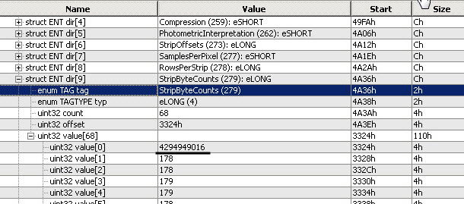
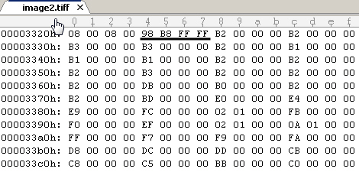
Integer Overflow to 0 by adding StripByteCounts values + JPEGInterchangeFormatLength (0x1484) together

Slide 12
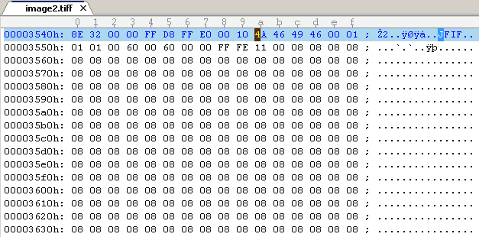
Modified JFIF inside TIFF File (Length 0x1484)
Take note of the large amount of 08 values !!!

Slide 13
Exploit Trace – Calculation and 0-Bytes allocation

Slide 14
Exploit Trace Memcpy of JFIF to 0-Bytes allocated HEAP-memory
Overwritten vftable from evil JFIF points to address 0x08080808

Slide 15
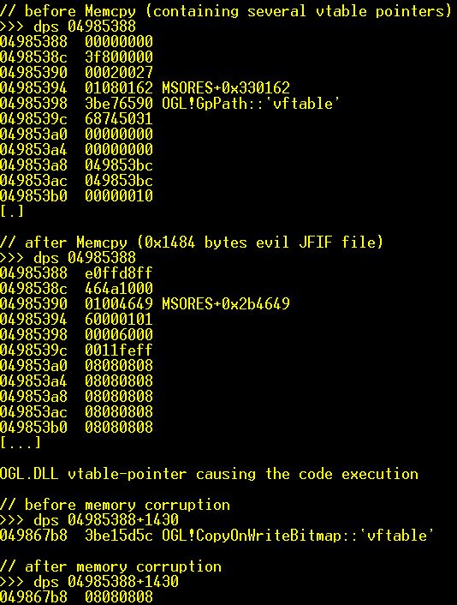
Vftable before and after corruption

Slide 16
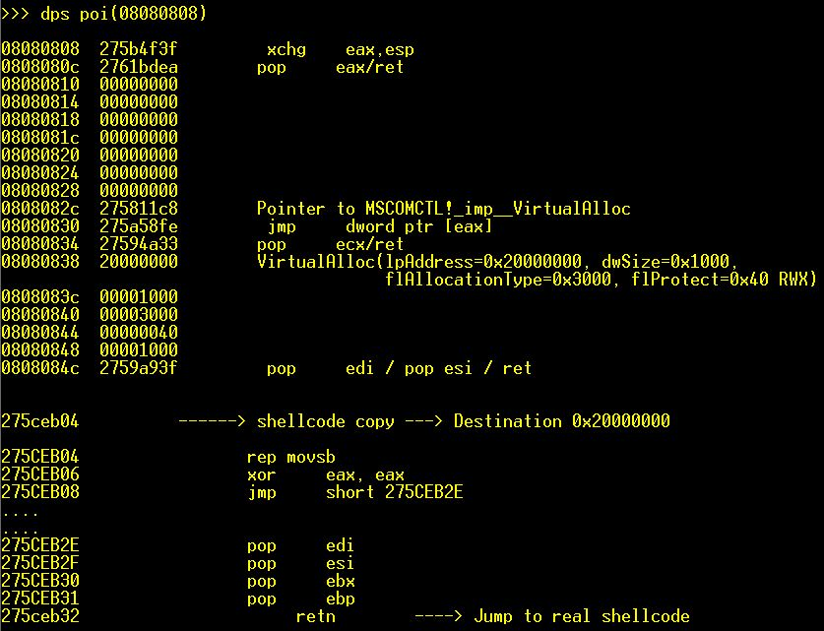
ROP Stage with MSCOMCTL.OCX code to bypass DEP

Slide 17
Payload decryption in shellcode inside activeX1.bin
Encrypted payload
Decrypted payload

Slide 18
Cheers to
Elia Florio
EP_X0FF
Aleks Matrosov
Thug4lif3

